Slide 1
Systems
IT 3105: Signals and Systems

Slide 2
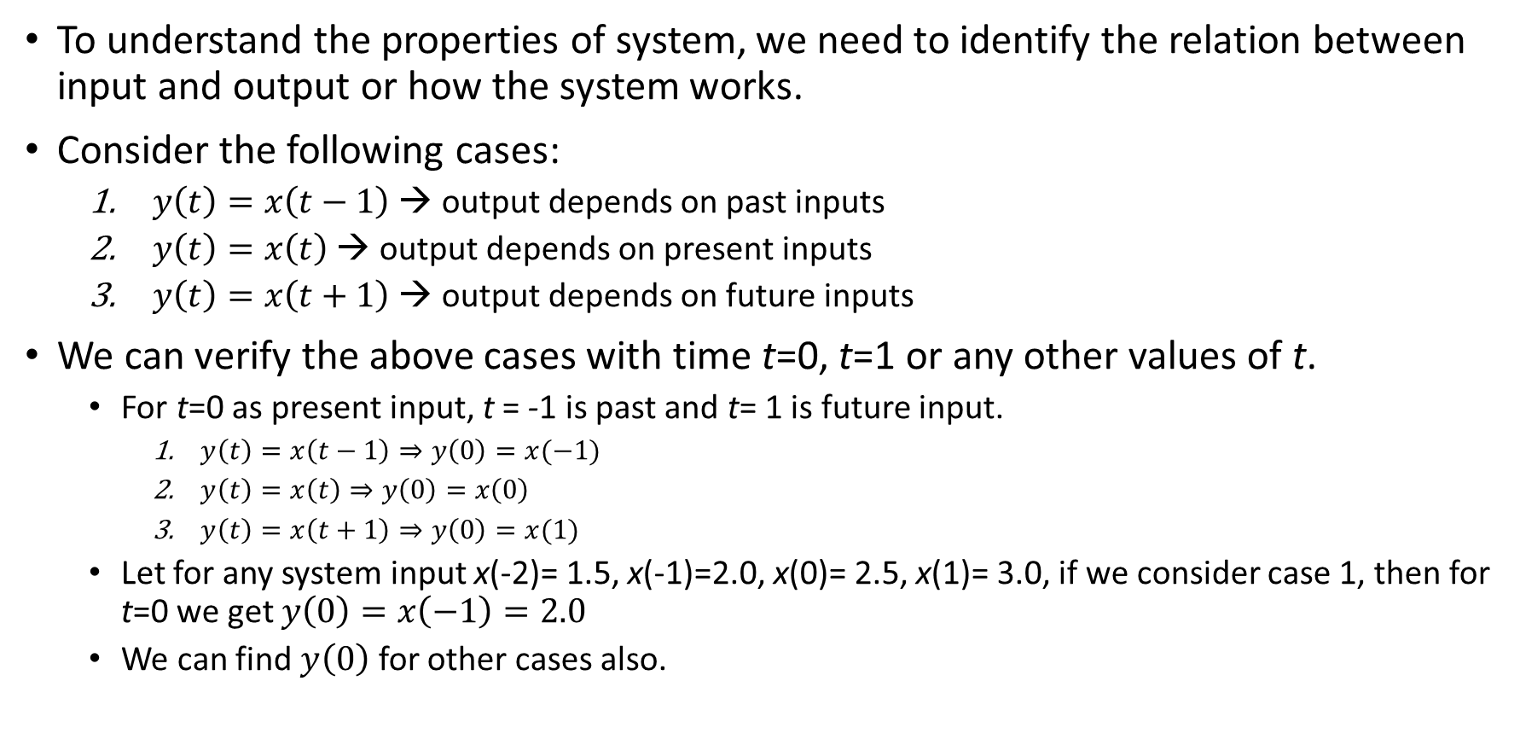
Basic System Properties
x(t)
System
y(t)
To understand the properties of system, we need to identify the relation between input and output or how the system works.
Consider the following cases:
$y\left(t\right)=x\left(t−1\right)$ → output depends on past inputs
$y\left(t\right)=x\left(t\right)$ → output depends on present inputs
$y\left(t\right)=x\left(t+1\right)$ → output depends on future inputs
We can verify the above cases with time t=0, t=1 or any other values of t.
For t=0 as present input, t = -1 is past and t= 1 is future input.
$y\left(t\right)=x\left(t−1\right)⇒y\left(0\right)=x(−1)$
$y\left(t\right)=x\left(t\right)⇒y\left(0\right)=x\left(0\right)$
$y\left(t\right)=x\left(t+1\right)⇒y\left(0\right)=x(1)$
Let for any system input x(-2)= 1.5, x(-1)=2.0, x(0)= 2.5, x(1)= 3.0, if we consider case 1, then for t=0 we get $y\left(0\right)=x\left(−1\right)=2.0$
We can find $y\left(0\right)$ for other cases also.

Slide 3
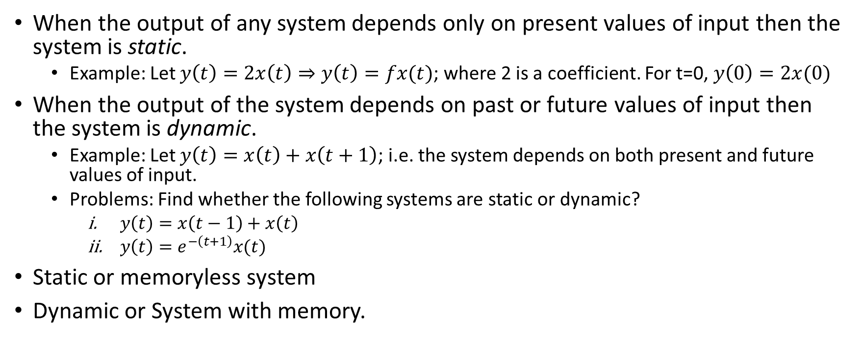
Static & Dynamic Systems
When the output of any system depends only on present values of input then the system is static.
Example: Let $y\left(t\right)=2x\left(t\right)⇒y\left(t\right)=fx(t)$; where 2 is a coefficient. For t=0, $y\left(0\right)=2x(0)$
When the output of the system depends on past or future values of input then the system is dynamic.
Example: Let $y\left(t\right)=x\left(t\right)+x\left(t+1\right)$; i.e. the system depends on both present and future values of input.
Problems: Find whether the following systems are static or dynamic?
$y\left(t\right)=x\left(t−1\right)+x\left(t\right)$
$y\left(t\right)=e^{−\left(t+1\right)}x(t)$
Static or memoryless system
Dynamic or System with memory.
x(t)
System
y(t)

Slide 4
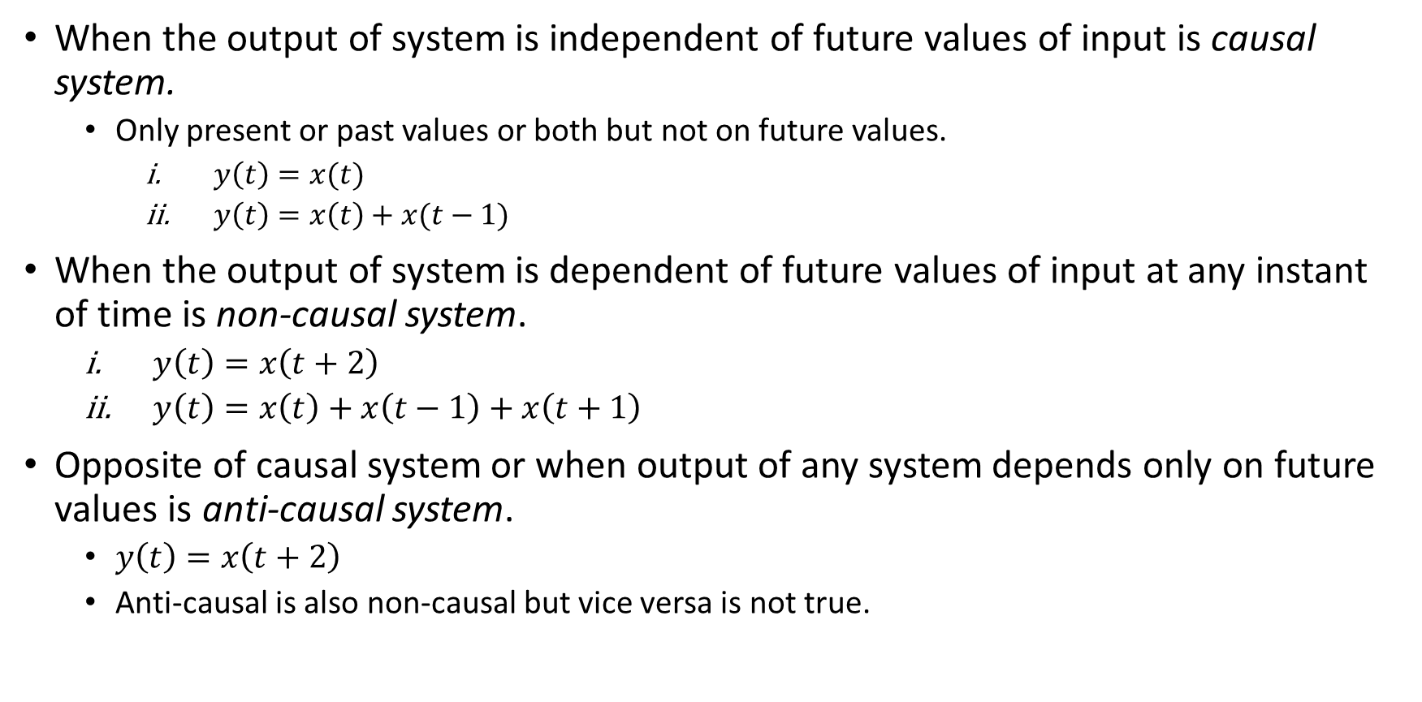
Causal & Non-causal System
When the output of system is independent of future values of input is causal system.
Only present or past values or both but not on future values.
$y\left(t\right)=x(t)$
$y\left(t\right)=x\left(t\right)+x(t−1)$
When the output of system is dependent of future values of input at any instant of time is non-causal system.
$y\left(t\right)=x\left(t+2\right)$
$y\left(t\right)=x\left(t\right)+x\left(t−1\right)+x\left(t+1\right)$
Opposite of causal system or when output of any system depends only on future values is anti-causal system.
$y\left(t\right)=x\left(t+2\right)$
Anti-causal is also non-causal but vice versa is not true.

Slide 5
Time Variant and Invariant Systems
When same amount of time delay apply on the input and output of any system and output remain same, then the system is time invariant, otherwise it is time variant.
System
y(t)
Delay by t₀
x(t)
y(t - t₀)
Delay by t₀
x(t-t₀)
System
x(t)
y₁(t)
If y(t - t₀) = y₁(t), then the systems are time invariant system or TIV system
If y(t - t₀) ≠ y₁(t), then the systems are time variant system or TV system

Slide 6
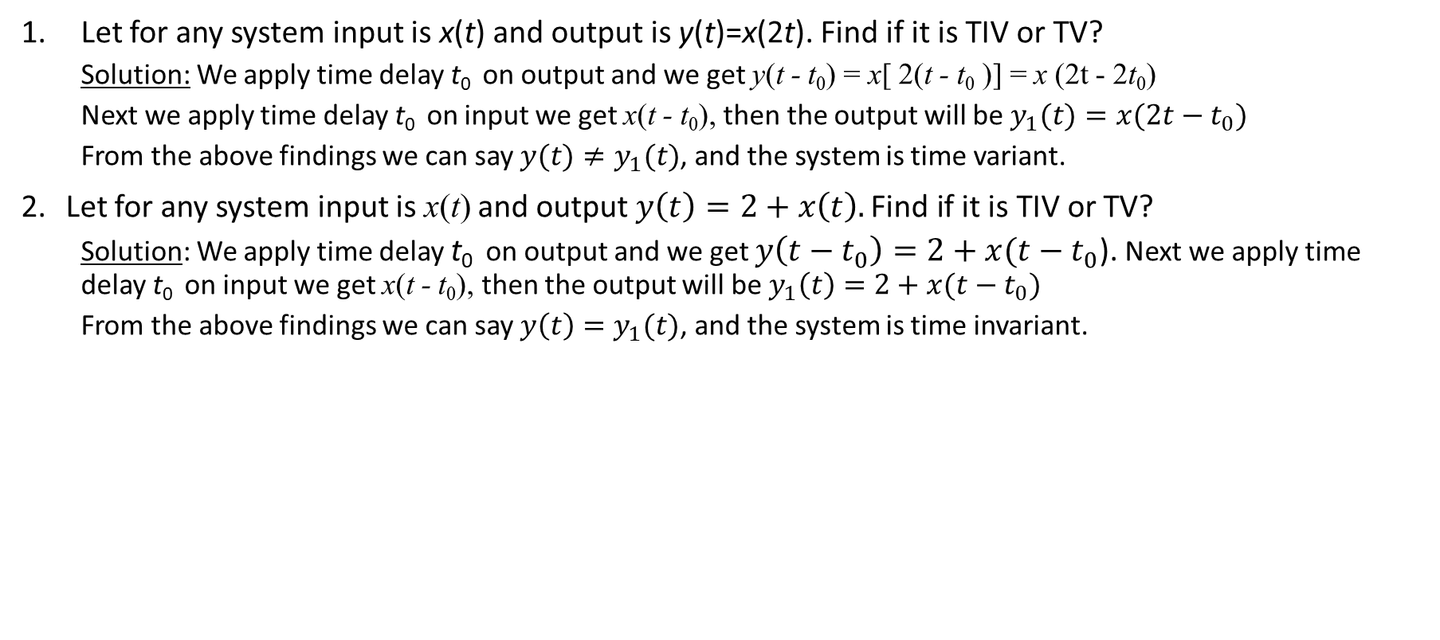
Examples:
Let for any system input is x(t) and output is y(t)=x(2t). Find if it is TIV or TV?
Solution: We apply time delay t₀ on output and we get y(t - t₀) = x[ 2(t - t₀ )] = x (2t - 2t₀)
Next we apply time delay t₀ on input we get x(t - t₀), then the output will be $y_{1}(t)=x(2t−t_{0})$
From the above findings we can say $y(t)≠y_{1}(t)$, and the system is time variant.
Let for any system input is x(t) and output $y\left(t\right)=2+x\left(t\right).\text{Find} \text{if} \text{it} \text{is} \text{TIV} \text{or} \text{TV}\text{?}$
Solution: We apply time delay t₀ on output and we get $y\left(t−t_{0}\right)=2+x(t−t_{0}$). Next we apply time delay t₀ on input we get x(t - t₀), then the output will be $y_{1}\left(t\right)=2+x(t−t_{0})$
From the above findings we can say $y\left(t\right)=y_{1}(t)$, and the system is time invariant.

Slide 7
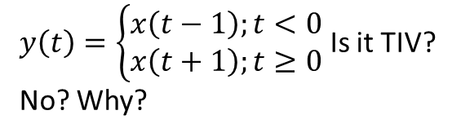
Properties of TV and TIV system
Important Points for TV:
For time scaling in I/P or O/P system will be time variant.
For amplitude scaling system is time in variant.
When the coefficient of function of time has time variable, the system will be time variant.
When any function of time is added or subtracted in output, the system is time variant.
Important Points for TIV:
No time scaling on I/P or O/P
Coefficient should be constant
Any added or subtracted term in system relationship i.e. must be constant or zero.
$y\left(t\right)=\left\{\begin{aligned}x\left(t−1\right);t<0 \\ x\left(t+1\right);t≥0\end{aligned}\right.$ Is it TIV?
No? Why?

Slide 8
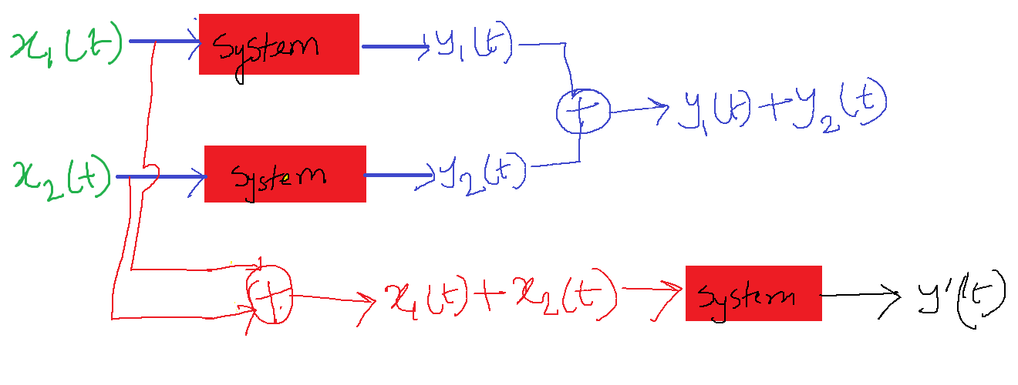
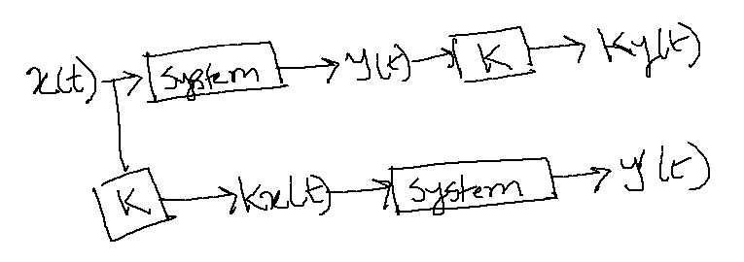
Linear & Non-linear System
System that satisfies the properties of superposition is said to be linear otherwise non-linear.
Principle of superposition: combination of two laws
Law of additively (LOA)
Law of homogeneity (LOH)

Slide 9
Example

Slide 10
Properties of Linear System
System linearity is independent of time scaling.
System linearity is independent of coefficients used in system relationship.
If any added or subtracted terms other in I/P or O/P of the system, can be found in system relationship the system will be non-linear.
If output is the summation of time shifted terms of input, the system will be linear.
Integral and differential operators are linear.
Even and odd operators are linear.
Real, imaginary and conjugate operators are non-linear.
Trigonometric, inverse trigonometric logarithmic, exponential, roots, powers, modulus, sgn, sa, sinc all functions are non-linear.
For zero input output is also zero for linear system.
Split systems are linear.

Slide 11
Example

Slide 12
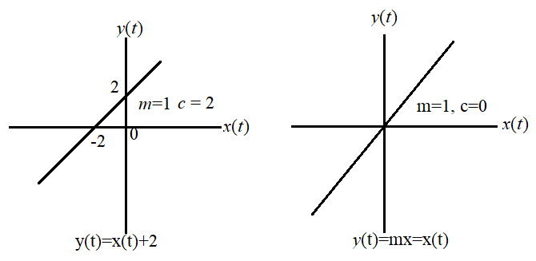
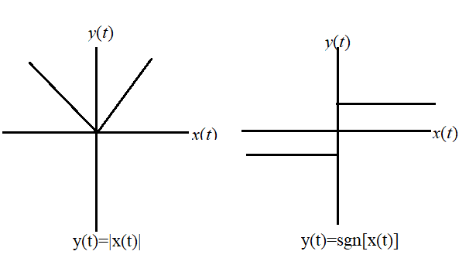
System’s Linearity from Transfer Characteristics

Slide 13
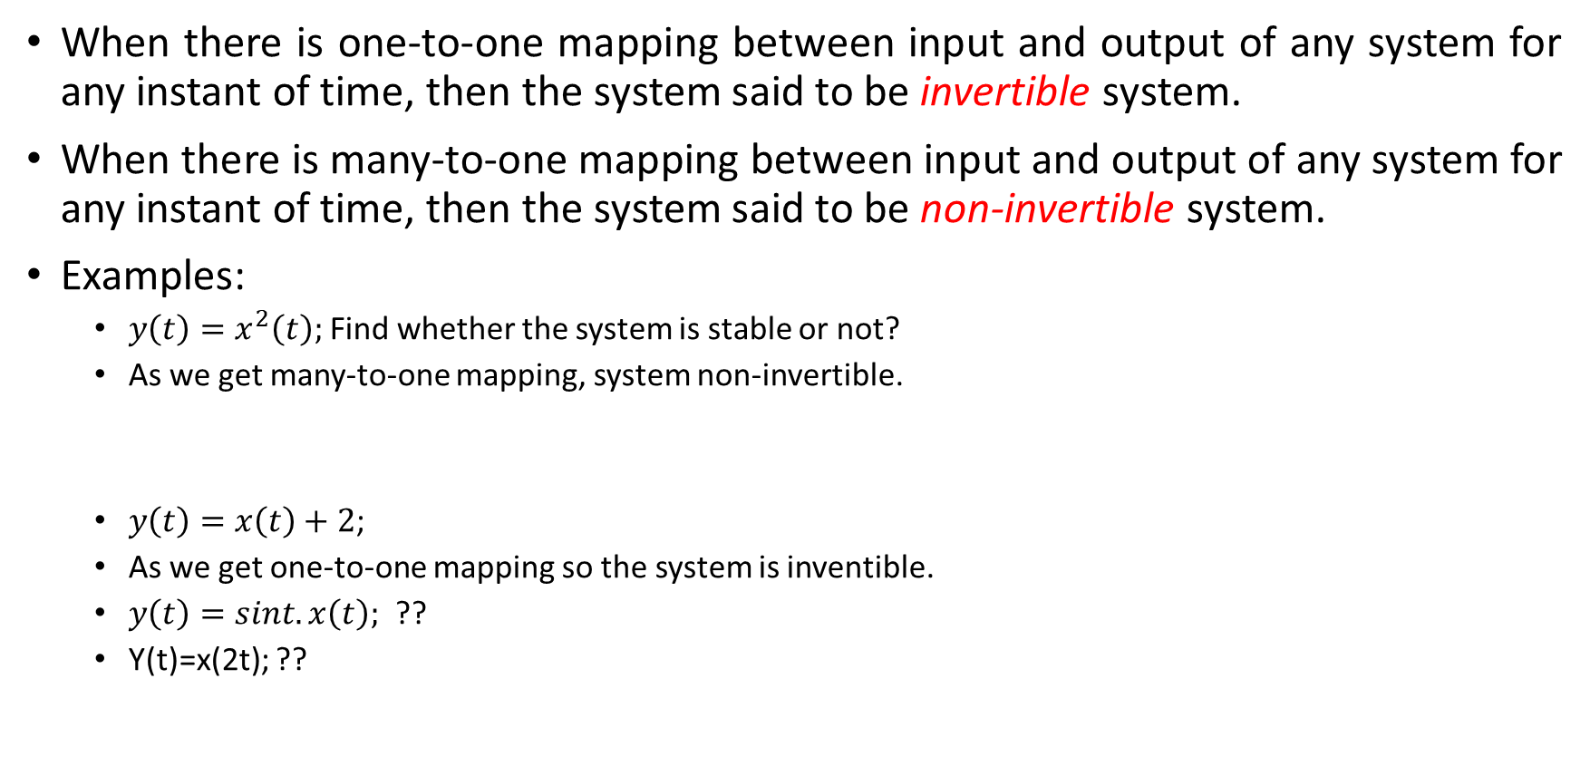
Invertible and Non-invertible System
When there is one-to-one mapping between input and output of any system for any instant of time, then the system said to be invertible system.
When there is many-to-one mapping between input and output of any system for any instant of time, then the system said to be non-invertible system.
Examples:
$y\left(t\right)=x^{2}\left(t\right);$Find whether the system is stable or not?
As we get many-to-one mapping, system non-invertible.
$y\left(t\right)=x\left(t\right)+2$;
As we get one-to-one mapping so the system is inventible.
$y\left(t\right)=sint.x\left(t\right);$ ??
Y(t)=x(2t); ??
x(t) | y(t)
-2 | 4
2
-3 | 9
3
x(t) | y(t)
0 | 2
1 | 3
-2 | 0

Slide 14
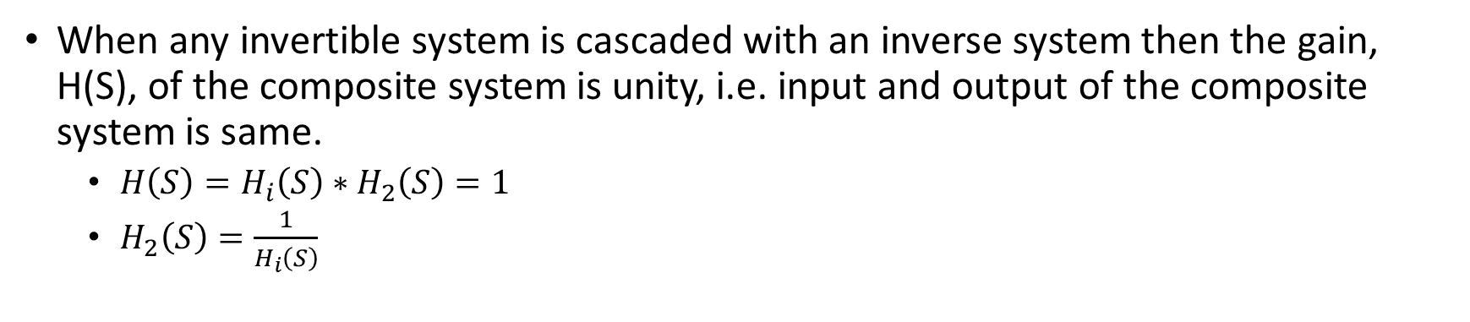
Property of Invertible System
Invertible System
Inverse System
Composite System
When any invertible system is cascaded with an inverse system then the gain, H(S), of the composite system is unity, i.e. input and output of the composite system is same.
$H\left(S\right)=H_{i}\left(S\right)∗H_{2}\left(S\right)=1$
$H_{2}\left(S\right)=\frac{1}{H_{i}\left(S\right)}$

Slide 15
Stable & Unstable System
BIBO criteria: Bounded input bounded output criteria.
For any stable system, o/p should be bounded for all bounded input for every instant of time.
Bounded means finite magnitude for every instant of time, i.e. from -∞ to ∞ of time magnitude of any signal is finite.
A system is said to be stable, if from -∞ to ∞ of time, the magnitude of signal is finite.
Any system is unstable if the o/p of the system is unbounded for any bounded i/p for time from -∞ to ∞ of time.

